Slide 1
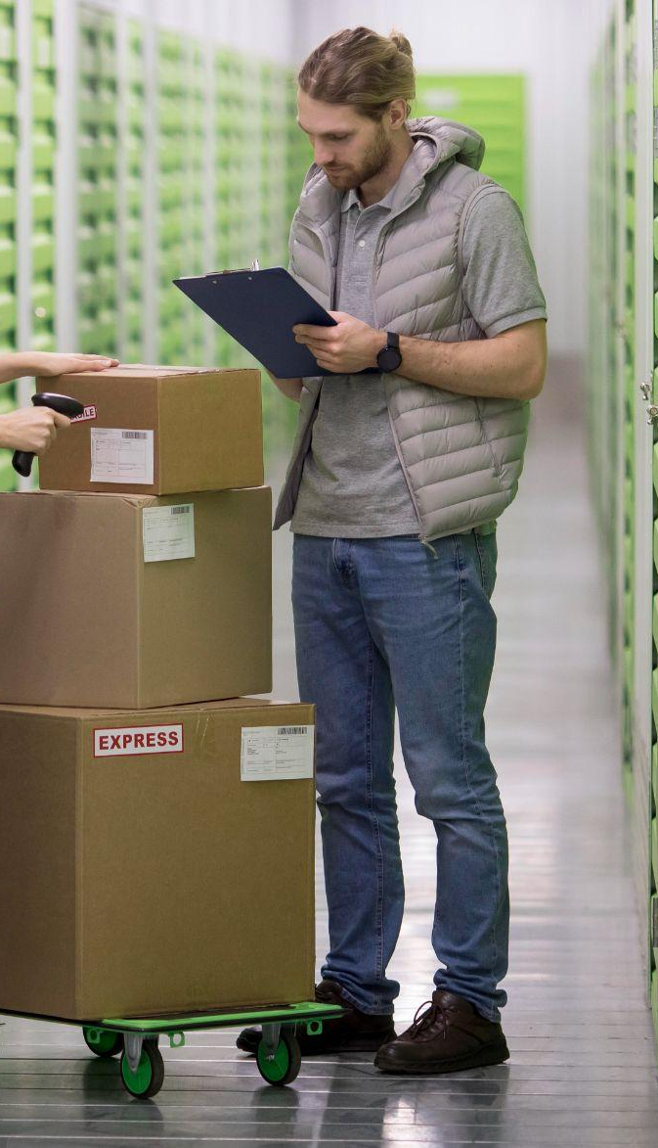
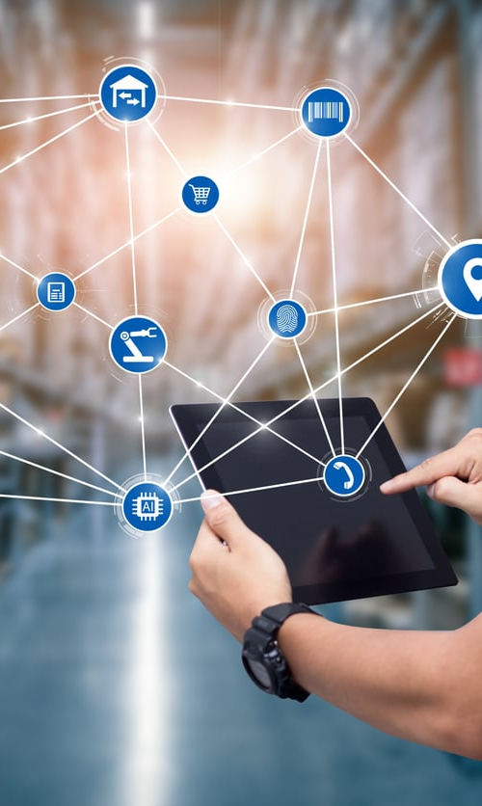
AI BASED SUPPLY CHAIN MANAGEMENT SYSTEM For Garments
PROJECT ID: 24-25J-065

Slide 2




GROUP MEMBERS
Mahagedara D N
IT21167614
Dilshan KTDN
IT21158704
Weerasinghe WMSRM
IT21373848
Widanapathirana YR
IT21312144

Slide 3
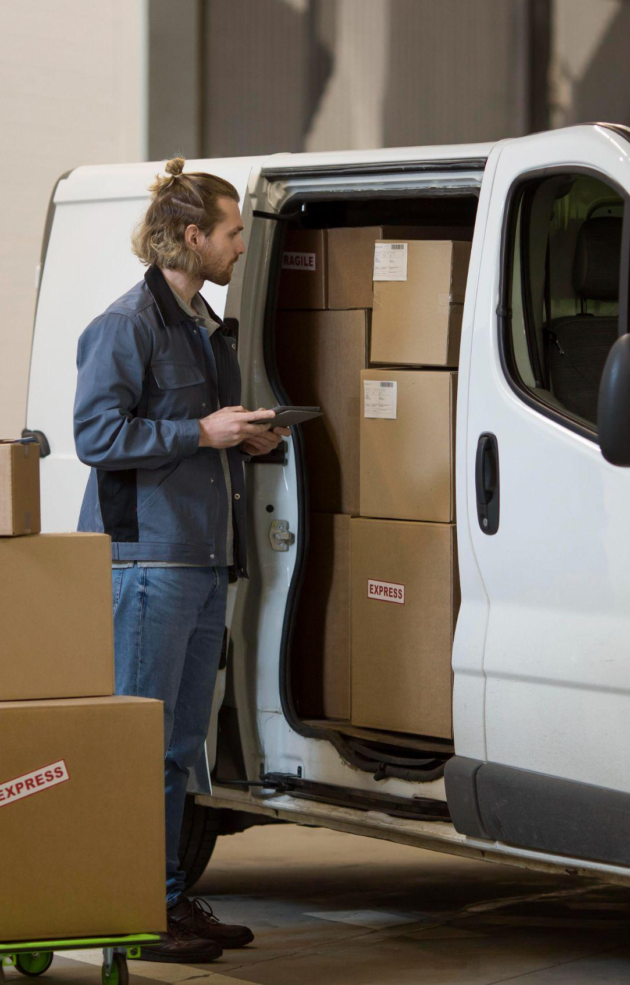
01. INTRODUCTION
Overview of Project
AI driven Supply chain management system
Target Audience - Small - Medium Scale Garments
Importance and Relevance
In the garment industry, several supply chain management systems are in use, but there are few or less systems that uses the AI technologies to optimise the overall system complexity and cost
Key Features
Production scheduling and optimization
Logistics and Transportation Optimization
Logistics and Packing Optimization for Transportation
Supplier Selection and Evaluation

Slide 4

02. RESEARCH PROBLEM
How can artificial intelligence be utilized to optimize supply chain management in the garment industry, focusing on production scheduling, logistics, packing, and supplier evaluation to achieve cost reduction and improved efficiency?

Slide 5
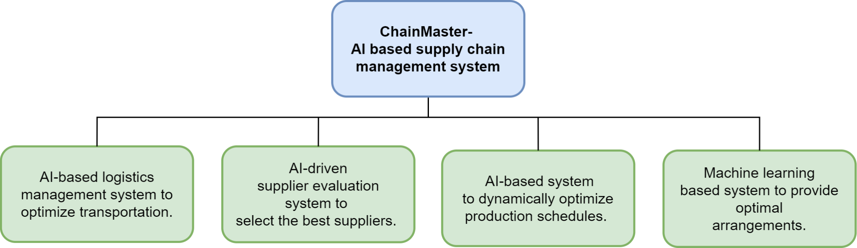
03. OBJECTIVES

Slide 6
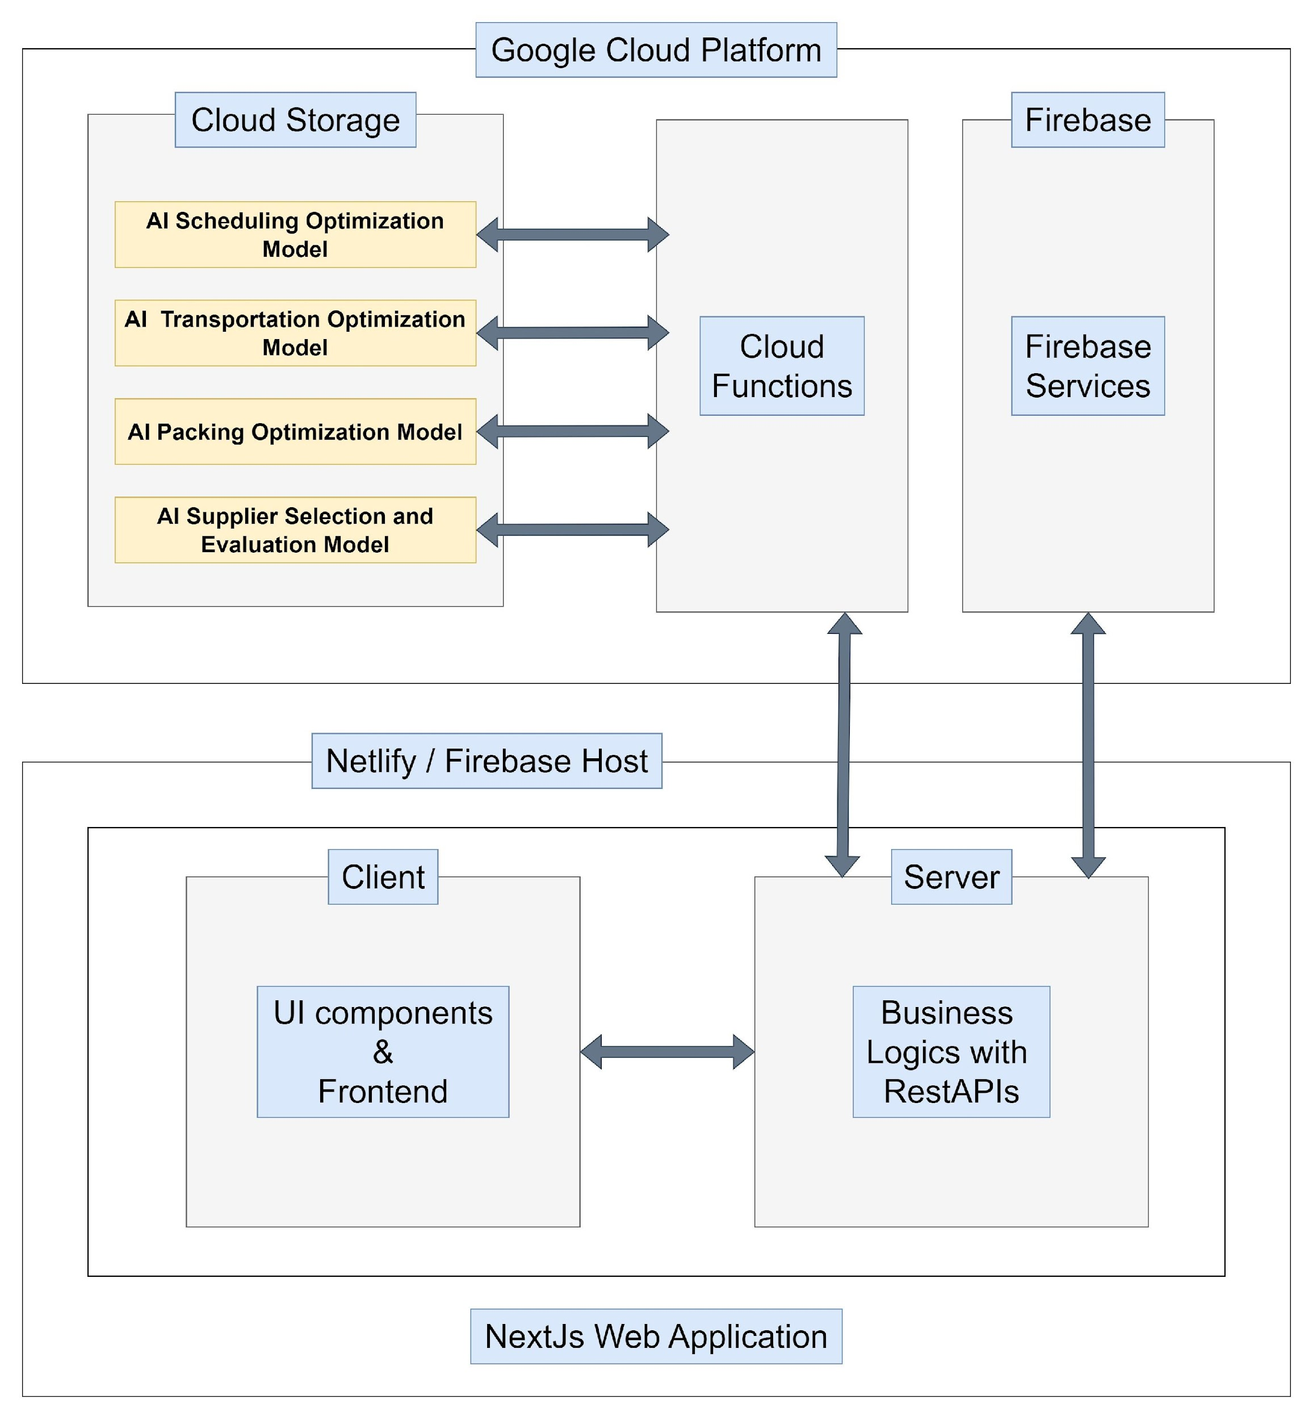
04. SYSTEM ARCHITECTURE (OVERALL)

Slide 7
AI-based Production Scheduling Optimization
IT21167614| Mahagedara D N
Software Engineering

Slide 8

5.1 What is production scheduling
01
02
What?
Common Behaviour
Production scheduling in the garment industry involves planning, coordinating, and managing the manufacturing process to ensure that garments are produced efficiently and on time.
One machine - One Part Of the item
Chain of machines for complete garment item
Sometimes machine bottlenecks occurs
Specific persons for each machine for get optimal performance
industrial engineer is the one who select machines and what are the machines that needs for each production line
IT21167614| Mahagedara D N | 24-25J-065

Slide 9

5.1.1 Problems & Solutions
One machine
01
02
Problems
Solutions
Manual processes with limited adaptability.
Difficulties in identifying bottlenecks manually
Uses reinforcement learning for dynamic optimization
Identifies production line bottlenecks and provide feedback on how to optimize
IT21167614| Mahagedara D N | 24-25J-065

Slide 10
5.2 Research Gap
Features | Proposed System | SAP Advanced Planning and Optimization [1] | Apparel Magic[2] | Uphance[3]
AI-based dynamic optimization | ✔️ | ❌ | ❌ | ❌
Real-time data integration | ✔️ | ❌ | ❌ | ❌
Reinforcement learning algorithms | ✔️ | ❌ | ❌ | ❌
User-friendly interface | ✔️ | ❌ | ✔️ | ✔️
IT21167614| Mahagedara D N | 24-25J-065

Slide 11




5.3 Technologies and Frameworks
Predictive Analytics & Machine Learning
TensorFlow,
Keras,
PyTorch
Deploy
Google Cloud
AWS
Data Handling
Database
Pandas
NumPy
Firebase Firestore DB
PostgreSQL
IT21167614| Mahagedara D N | 24-25J-065

Slide 12
5.4 Objectives for Sub-Component
Data Collection
Model Training
Gathering Machine Details, Performance details
Machine counts and etc.
Develop and train analytics models for optimize the throughput of production line
System Integration
User Interface
Seamless integration with other components within the system,
Develop a minimalistic UI that can easily interact with any person
IT21167614 | Mahagedara D N | 24-25J-065

Slide 13
5.5 Methodology
Data Collection and Analysis
Model Development
Develop Reinforcement Learning Algorithm
Train and Fine-tune Model
System Integration
Integrate Scheduling Model with Production System
Develop User Interface for Scheduling
Testing and Feedback
Conduct User Testing
IT21167614 | Mahagedara D N | 24-25J-065

Slide 14
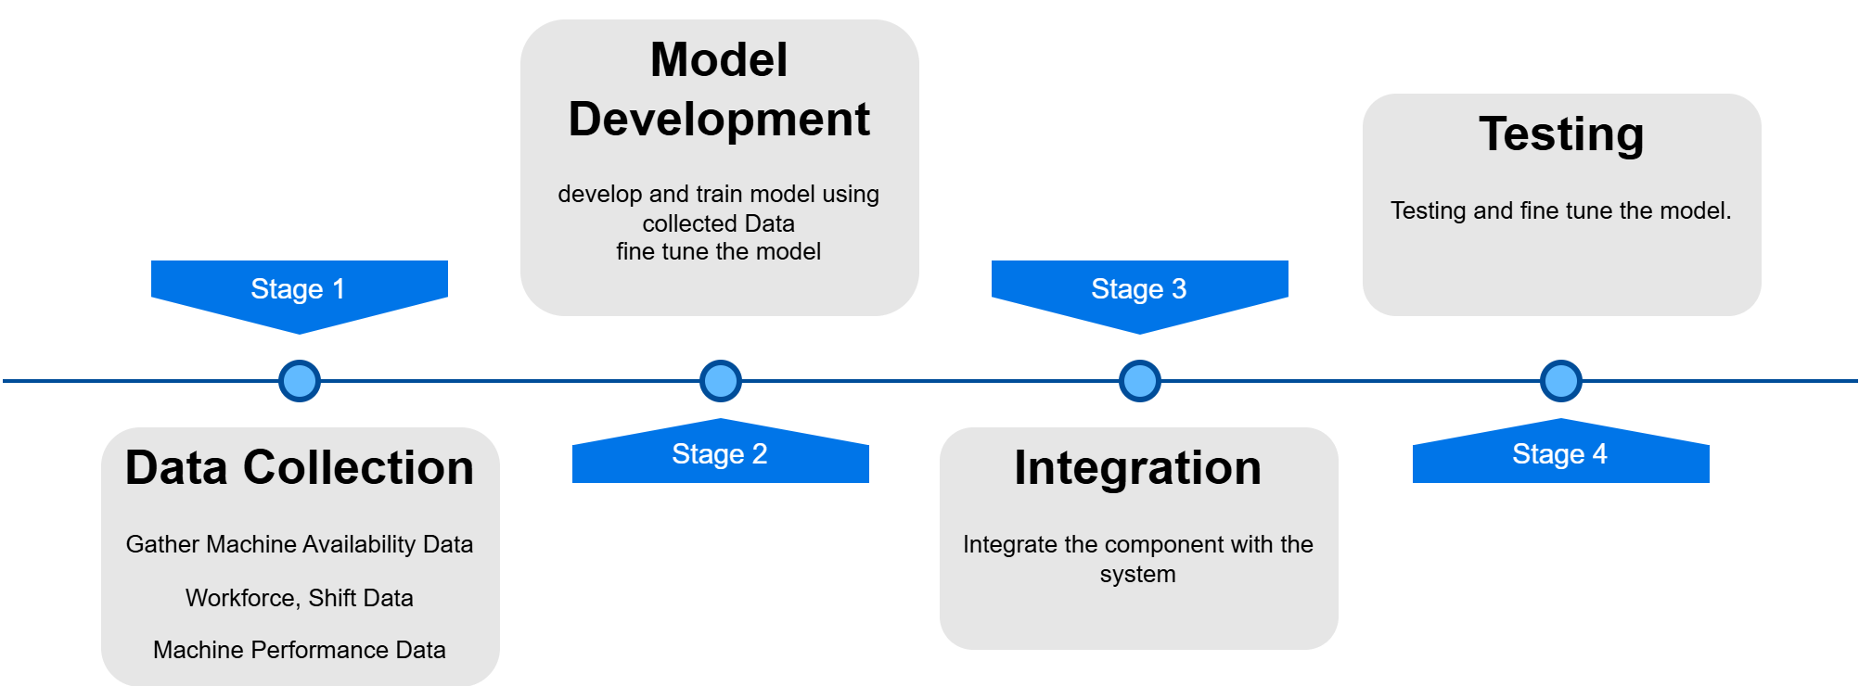
5.6 Work-Breakdown Structure
IT21167614 | Mahagedara D N | 24-25J-065

Slide 15
5.7 Gantt Chart
No | Objective | June | July | Aug | Sep | Oct | Nov | Dec | Jan | Feb | Mar | Apr | May
01 | Data Collection and Planning
02 | Develop basic system and train the AI model
03 | Integration with the system
04 | Testing and fine tune the system
05 | Delivery
IT21167614 | Mahagedara D N | 24-25J-065

Slide 16
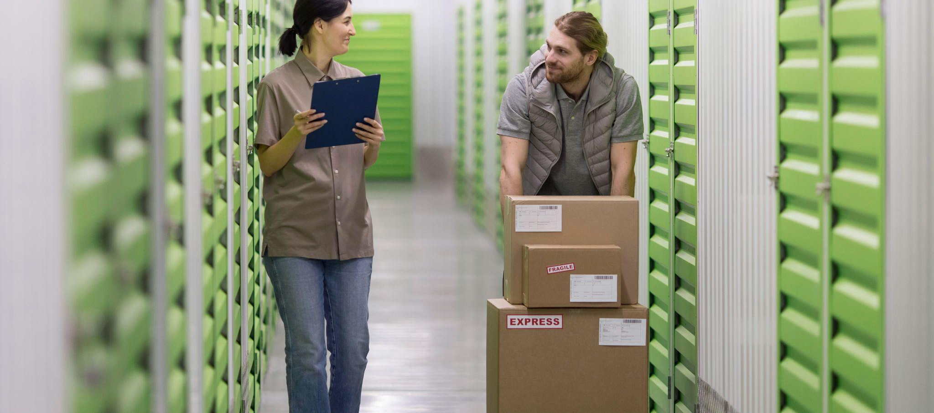
REFERENCES
SAP Advanced Planning and Optimization: Penchev, P., Vitliemov, P., & Georgiev, I. (2023). Optimization model for production scheduling taking into account preventive maintenance in an uncertainty-based production system. Heliyon, 9(3), e17485. Available: https://doi.org/10.1016/j.heliyon.2023.03.17485
ApparelMagic: Ginsberg, B. Supply Chain Management in the Apparel Industry. ApparelMagic. Available: https://apparelmagic.com/supply-chain-management-in-the-apparel-industry
ABS Apparel Management System: "The Benefits of Apparel Software for Your Supply Chain," Apparel Business. Available: https://www.apparelbusiness.com
Uphance: "Revamp Your Apparel Supply Chain for Speed & Flexibility," Uphance. Available: https://www.uphance.com/revamp-your-apparel-supply-chain-for-speed-flexibility
IT21167614 | Mahagedara D N | 24-25J-065

Slide 17
AI-based Logistics and Transportation Optimization
IT21158704 | Dilshan KTDN
Software Engineering

Slide 18
6.1 Research Questions
01
02
How can AI algorithms be utilized to optimize transportation routes for raw materials and finished products in the garment industry to minimize delivery times and costs?
How can real-time data be effectively integrated into AI models to optimize transportation
IT21158704| Dilshan KTDN | 24-25J-065

Slide 19
6.2 Research Gap
Features | Proposed System | SAP Advanced Planning and Optimization[1] | Apparel Magic[2] | Uphance[3]
Real-time route optimization | ✔️ | ✔️ | ✔️ | ✔️
Predictive analytics for delays | ✔️ | ✔️ | ✔️ | ✔️
Alternative route suggestions | ✔️ | ❌ | ❌ | ✔️
Dynamic vehicle allocation | ✔️ | ❌ | ❌ | ❌
Real-time Traffic and Weather Updates | ✔️ | ❌ | ❌ | ❌
IT21158704| Dilshan KTDN | 24-25J-065

Slide 20






6.3 Technologies and Frameworks
Predictive Analytics & Machine Learning
Scikit-learn
XGBoost
Data Handling
Database
Pandas
NumPy
Firebase Firestore DB
PostgreSQL
IT21158704| Dilshan KTDN | 24-25J-065

Slide 21
6.4 Objectives for Sub-Component
Data Collection
Model Training
Gather Logistics and Transportation Data and Collect Real-time Traffic and Weather Data
Develop and train predictive analytics models for optimizing transportation routes and schedules based on real-time logistics data.
System Integration
User Interface
Embed predictive analytics models within logistics management systems to optimize transportation routes and schedules.
Design the interfaces to display recommended vehicles, routes according to the predictive analytics
IT21158704| Dilshan KTDN | 24-25J-065

Slide 22
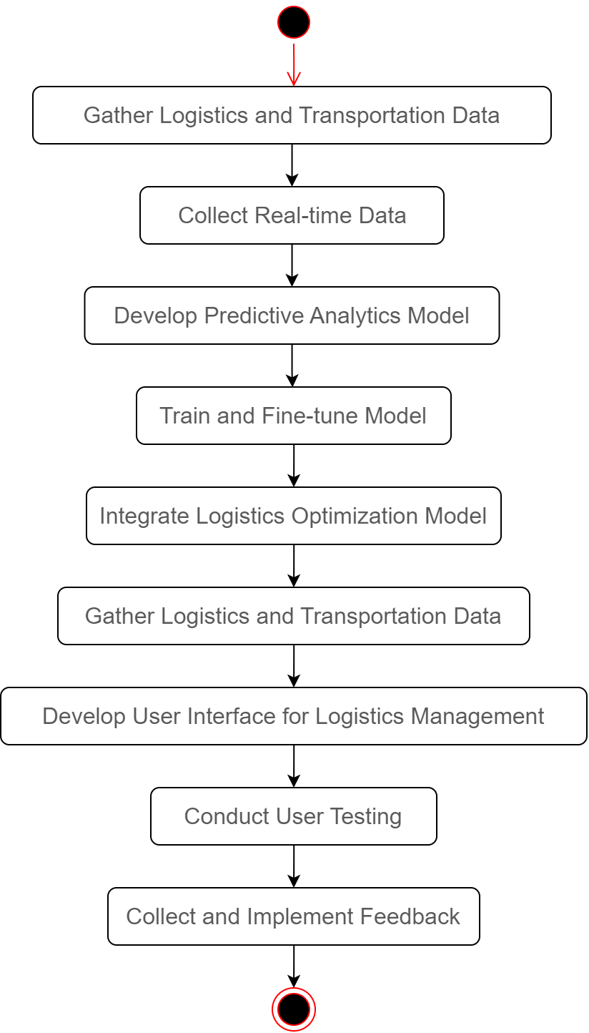
6.5 Methodology
IT21158704| Dilshan KTDN | 24-25J-065

Slide 23
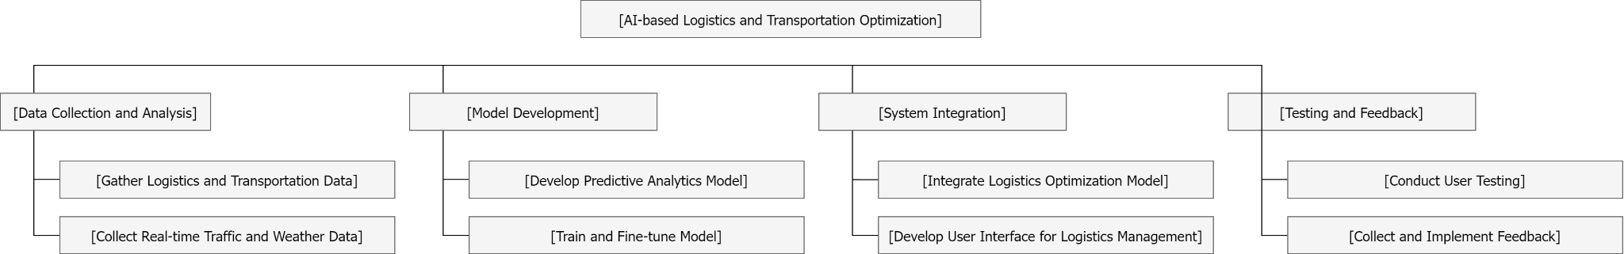
6.6 Work-Breakdown Structure
IT21158704| Dilshan KTDN | 24-25J-065

Slide 24
6.7 Gantt Chart
No | Objective | Jun | Jul | Aug | Sep | Oct | Nov | Dec | Jan | Feb | Mar | Apr | May
01 | Gather Logistics and Transportation Data
02 | Collect Real-time Data
03 | Develop Predictive Analytics Model
04 | Train and Fine-tune Model
05 | Integrate Logistics Optimization Model
06 | Develop User Interface for Logistics Management
07 | Conduct User Testing
08 | Collect and Implement Feedback
IT21158704| Dilshan KTDN | 24-25J-065

Slide 25
REFERENCES
[1]Penchev, P., Vitliemov, P., & Georgiev, I. (2023). Optimization model for production scheduling taking into account preventive maintenance in an uncertainty-based production system. Heliyon, 9(3), e17485.
https://doi.org/10.1016/j.heliyon.2023.03.17485
[2]Ginsberg, B. Supply Chain Management in the Apparel Industry. ApparelMagic. https://apparelmagic.com/supply-chain-management-in-the-apparel-industry
[3]"Revamp Your Apparel Supply Chain for Speed & Flexibility," Uphance. https://www.uphance.com/revamp-your-apparel-supply-chain-for-speed-flexibility
IT21158704| Dilshan KTDN | 24-25J-065

Slide 26
AI-based Logistics and Packaging Optimization for Transportation
IT21373848 | Weerasinghe WMSRM
Software Engineering

Slide 27
7.1 Research Problem
01
02
Inefficient transportation management leading to increased costs and delays.
Suboptimal packing methods causing poor space utilization in shipping containers.
IT21373848 | Weerasinghe WMSRM | 24-25J-065

Slide 28
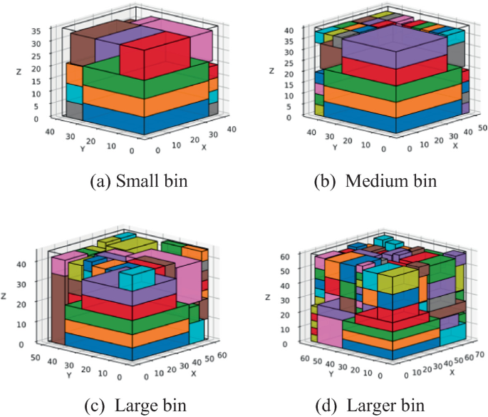
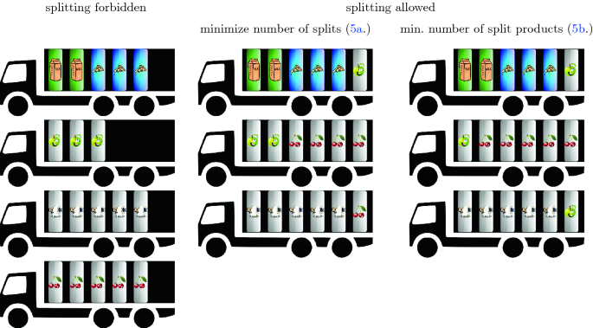
Bin packing
A set of items of various sizes has to be packed into a minimum number of identical bins.
IT21373848 | Weerasinghe WMSRM | 24-25J-065

Slide 29
7.2 Research Gap
Features | Proposed System | 3DBinPacking.com [1] | Packing Optimizer [2] | ShipHawk's Smart Packing[3]
Packing Optimization | ✔️ | ✔️ | ✔️ | ✔️
Get dimensions by image processing | ✔️ | ✔️ | ❌ | ❌
Predictive models for dynamic optimization | ✔️ | ❌ | ❌ | ❌
AI-based flexible and adaptive algorithms | ✔️ | ❌ | ❌ | ❌
SAP Advanced Planning and Optimization, ApparelMagic, Uphance does not support packing optimization.
IT21373848 | Weerasinghe WMSRM | 24-25J-065

Slide 30
7.3 Technologies and Frameworks
Predictive Analytics & Machine Learning
Programming Languages: Python, TypeScript
ML Frameworks: TensorFlow, Keras, PyTorch
Database: Firebase Firestore
Frontend: NextJs
IT21373848 | Weerasinghe WMSRM | 24-25J-065

Slide 31
7.4 Objectives for Sub-Component
Data Collection
Model Training
Package dimensions, weights, and constraints.
Transportation vehicle dimensions, capacities
packing arrangements
optimize packaging arrangements considering multiple attributes such as weight, volume, and fragility.
System Integration
User Interface
Integrate AI-driven packing optimization models with existing logistics and transportation management systems.
Design intuitive interfaces to display optimized packing arrangements and recommendations.
Provide interactive tools for users to input constraints and preferences for packaging.
IT21373848 | Weerasinghe WMSRM | 24-25J-065

Slide 32
7.5 Methodology
Data Collection
Model Development
System Integration
User Interface Design:
Testing and Evaluation:
Deployment and Maintenance:
Benefits
Enhanced space utilization.
Reduced shipping costs.
Efficient handling and transportation of goods.
IT21373848 | Weerasinghe WMSRM | 24-25J-065

Slide 33
7.6 Work-Breakdown Structure
1. Initialization
- Define Scope
- Identify Stakeholders
- Gather Requirements
2. Data Collection
- Historical Data
- Real-Time Data
- Data Preprocessing
3. Model Development
- Select Algorithms
- Train Models
- Validate Models
4. Integration
- Develop APIs
- Integrate with Systems
- Automate Packaging
5. UI Design
- Design Interfaces
- Develop Input/Visualization
6. Testing
- Define Metrics
- Pilot Testing
- Optimize Models
7. Deployment
- Deploy System
- Maintenance Plan
- Regular Updates
IT21373848 | Weerasinghe WMSRM | 24-25J-065

Slide 34
7.7 Gantt Chart
No | Objective | Jun | Jul | Aug | Sep | Oct | Nov | Dec | Jan | Feb | Mar | Apr | May
01 | Problem Definition and Requirements Gathering
02 | Data Collection
03 | Data Preprocessing
04 | Model Development
05 | Model Training and Validation
06 | System Integration
07 | User Interface Design
08 | Evaluation and Optimization
09 | Deployment and Maintenance
IT21373848 | Weerasinghe WMSRM | 24-25J-065

Slide 35
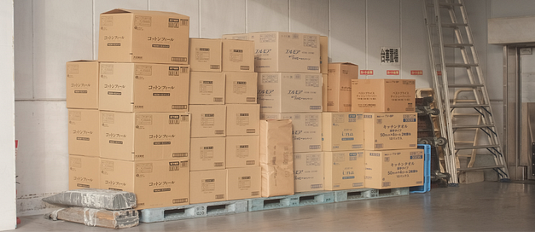
REFERENCES
Bansal, Nikhil, Jose R. Correa, Claire Kenyon and Maxim Sviridenko (2006), “Bin packing in multiple dimensions: inapproximability results and approximation schemes”, Mathematics of Operations Research, Vol. 31, pp. 31-49.
Jylanki, Jukka (2015), “A Thousand Ways to Pack the Bin — A Practical Approach to Two-Dimensional Rectangle Bin Packing”, http://pds25.egloos.com/pds/201504/21/98/RectangleBinPack.pdf
Optioryx (2023), “Choosing The Shipping Box Dimensions That Fit Your Order Profile”, Medium, https://medium.com/@optioryx/choosing-the-shipping-box-dimensions-that-fit-your-order-profile-729a3ea01de7
IT21373848 | Weerasinghe WMSRM | 24-25J-065

Slide 36

AI-based Supplier Selection and Evaluation:
IT21312144 | Widanapathirana
Software Engineering

Slide 37
8.1 Research Questions
01
02
How can machine learning algorithms be utilized to accurately assess supplier performance based on historical data, quality metrics, and cost efficiency?
What impact does the implementation of an AI-driven supplier recommendation system have on procurement decision-making and overall supply chain efficiency in the garment industry?
IT21312144 | Widanapathirana YR | 24-25J-065

Slide 38
8.2 Research Gap
Features | Proposed System | AIPA (Ref [20]) | Big Data Analytics System (Ref [21]) | Multi-criteria Supplier Selection Model (Ref [21])
Machine learning algorithms | ✔️ | ✔️ | ✔️ | ✔️
Past performance assessment | ✔️ | ✔️ | ✔️ | ✔️
Quality metrics analysis | ✔️ | ✔️ | ✔️ | ✔️
Cost efficiency analysis | ✔️ | ❌ | ❌ | ❌
Real-time recommendation system | ✔️ | ✔️ | ❌ | ❌
Sustainability considerations | ✔️ | ❌ | ❌ | ✔️
IT21312144 | Widanapathirana YR | 24-25J-065
Notes:
Artificial Intelligence Procurement Assistant (AIPA):
Capabilities: Enhances procurement processes by integrating AI for analyzing procurement opportunities, focusing on efficiency in bid evaluation.
Limitation: Does not comprehensively address cost efficiency and lacks a dedicated real-time recommendation system【20†source】.
Mu​ (SpringerLink)​ased Big Data Analytics System:
Capabilities: Uses multi-agent systems and big data analytics for supplier selection, focusing on viable supplier choices.
Limitation: Does not incorporate a real-time recommendation system or focus on cost efficiency【21†source】.
Mu​ (SpringerLink)​a Supplier Selection Model for Sustainable Supply Chain:
Capabilities: Employs a two-stage decision-making process to select suppliers, emphasizing sustainability and managing uncertainty in the supply chain.
Limitation: Lacks integration of a real-time recommendation system and comprehensive cost efficiency analysis【21†source】.
Resea​ (SpringerLink)​lysis: The proposed AI-driven supplier evaluation system differentiates itself by integrating several advanced features not comprehensively addressed by existing studies:
Cost Efficiency Analysis: Unlike the referenced systems, the proposed system includes a detailed cost efficiency analysis, ensuring that suppliers are not only evaluated based on performance and quality but also on their cost-effectiveness.
Real-time Recommendation System: The inclusion of a real-time recommendation system allows procurement teams to make informed decisions quickly, a feature that is not present in most existing systems.
Comprehensive Evaluation: By combining past performance, quality metrics, and cost efficiency, the proposed system offers a more holistic and accurate evaluation of suppliers.
References:
Artificial Intelligence Procurement Assistant: Enhancing Bid Evaluation:
SpringerLink. (2023). AIPA Overview【20†source】.
A ​ (SpringerLink)​ Based Big Data Analytics System for Viable Supplier Selection:
Journal of Intelligent Manufacturing. (2023). Big Data Analytics【21†source】.
A ​ (SpringerLink)​ulti-criteria Supplier Selection Model for Sustainable Automotive Supply Chain Under Uncertainty:
Axioms. (2022). Sustainable Supply Chain【21†source】.

Slide 39
8.3 Technologies and Frameworks
Programming Languages
Machine Learning Libraries
Python
TypeScript
Scikit-learn
TensorFlow
Database
Frontend/Backend
Firebase
Firestore
NextJs
IT21312144 | Widanapathirana YR | 24-25J-065

Slide 40
8.4 Objectives for Sub-Component
Data Collection
Model Training
Gather comprehensive and high-quality data on supplier performance, quality metrics, and cost efficiency.
Develop and train machine learning models to evaluate suppliers based on collected data.
System Integration
User Interface
Integrate the AI-driven supplier evaluation system into existing procurement and supply chain management systems.
Design a user-friendly interface for procurement teams to interact with the AI system.
IT21312144 | Widanapathirana YR | 24-25J-065
Notes:
Data Collection
Objective: Gather comprehensive and high-quality data on supplier performance, quality metrics, and cost efficiency.
Details:
Collect historical data from various suppliers including delivery times, defect rates, and service quality.
Use IoT devices and sensors to gather real-time data on supplier operations.
Implement web scraping techniques to collect data from public sources and supplier websites.
Model Training
Objective: Develop and train machine learning models to evaluate suppliers based on collected data.
Details:
Use supervised learning algorithms to train models on historical performance data.
Apply unsupervised learning techniques to identify patterns and anomalies in supplier behavior.
Continuously update models with new data to improve accuracy and relevance.
System Integration
Objective: Integrate the AI-driven supplier evaluation system into existing procurement and supply chain management systems.
Details:
Ensure seamless data flow between the AI system and ERP (Enterprise Resource Planning) software.
Develop APIs (Application Programming Interfaces) for easy integration with other business applications.
Implement security protocols to protect data integrity and confidentiality.
User Interface
Objective: Design a user-friendly interface for procurement teams to interact with the AI system.
Details:
Develop dashboards that display key supplier performance metrics and recommendations.
Ensure the interface is intuitive and accessible, with customizable views and reports.
Incorporate interactive features such as alerts and notifications for real-time decision-making.

Slide 41
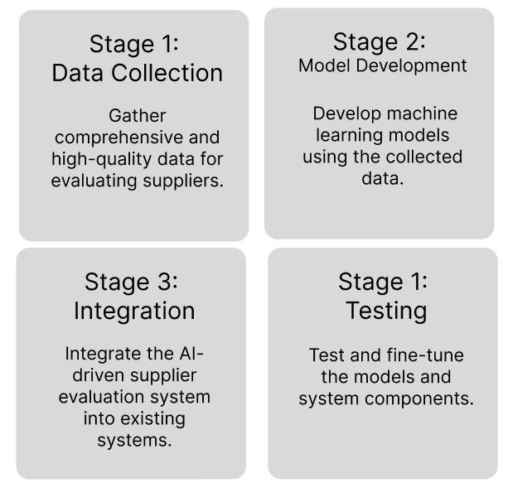
8.6 Work-Breakdown Structure
IT21312144 | Widanapathirana YR | 24-25J-065

Slide 42
8.7 Gantt Chart
No | Objective | Jun | Jul | Aug | Sep | Oct | Nov | Dec | Jan | Feb | Mar | Apr | May
01 | Problem Definition and Requirements Gathering
02 | Data Collection
 | Data Preprocessing
 | Model Development
 | Model Training and Validation
 | System Integration
 | User Interface Design
 | Evaluation and Optimization
 | Deployment and Maintenance
IT21312144 | Widanapathirana YR | 24-25J-065

Slide 43
8.5 Methodology
Data Collection
Model Development
System Integration
User Interface Design:
Testing and Evaluation:
Deployment and Maintenance:
Impact and Benefits
Enhanced Decision-Making
Cost Savings
Improved Supplier Performance
Operational Efficiency
IT21312144 Widanapathirana YR | 24-25J-065

Slide 44
REFERENCES
Artificial Intelligence Procurement Assistant: Enhancing Bid Evaluation:
SpringerLink. (2023). AIPA Overview【20†source】.
A ​ (SpringerLink)​ Based Big Data Analytics System for Viable Supplier Selection:
Journal of Intelligent Manufacturing. (2023). Big Data Analytics【21†source】.
A ​ (SpringerLink)​ multi-criteria Supplier Selection Model for Sustainable Automotive Supply Chain Under Uncertainty:
Axioms. (2022). Sustainable Supply Chain【21†source】.
IT21158704| Widanapathirana YR | 24-25J-065

Slide 45
10. BUDGET (OVERALL)
Category | Estimated Cost (LKR)
Development (Application, Model, Testing) | 110,000/=
Hardware (Servers and Equipment) | 40,000/=
Operational Costs | 20,000/=
Reserve Fund (Unexpected Costs) | 10,000/=
Total Estimated Cost | 180,000/=
IT21158704| Widanapathirana YR | 24-25J-065

Slide 46
Conclusion
Integrated AI Solutions
Efficiency & Cost Reduction
Real-Time Adaptability

Slide 47
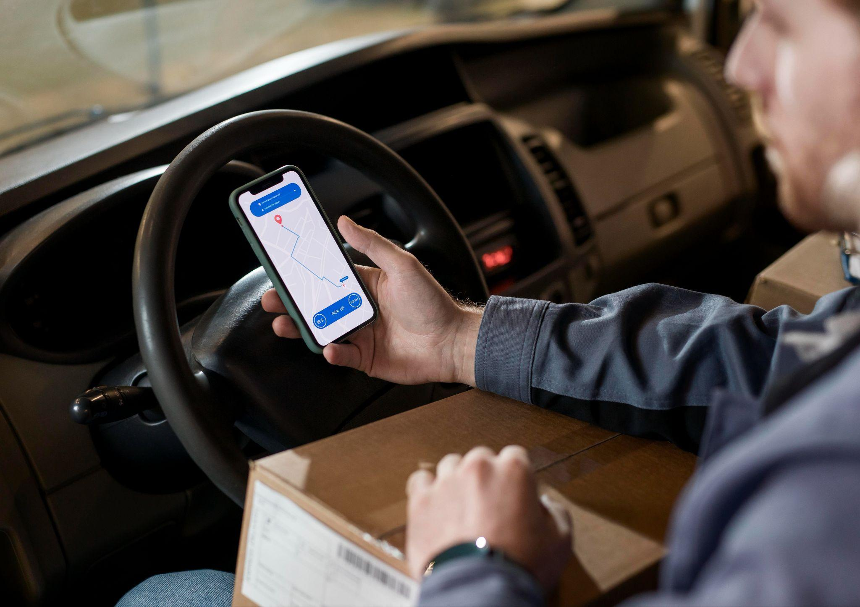

THANK YOU!

